Slide 1

David M. Kroenke and David J. Auer Database Processing Fundamentals, Design, and Implementation
Chapter Ten A:
Managing Databases with
SQL Server 2012

Slide 2
Chapter Objectives
To install SQL Server 2012 and create a database
To use SQL Server 2012’s graphical utilities
To create a database in SQL Server 2012
To submit both SQL DDL and DML via the Microsoft SQL Server Management Studio
To understand the use of SQL/Persistent Stored Modules (SQL/PSM) in Microsoft Transact-SQL
To understand the purpose and role of user-defined functions and know how to create simple user-defined functions

Slide 3
Chapter Objectives
To understand the purpose and role of stored procedures and know how to create simple stored procedures
To understand the purpose and role of triggers and know how to create simple triggers
To understand how SQL Server implements concurrency control
To understand how SQL Server 2012 implements server and database security
To understand the fundamental features of SQL Server backup and recovery facilities

Slide 4
Introduction
There are several versions of SQL Server 2012, of which three are significant for our purposes:
Enterprise Edition—This is the most powerful and feature-laden version. It handles up to eight CPU’s, 2 TBytes of memory and a maximum database size of 524 Petabytes (PBytes). It includes full data warehouse capabilities.
Standard Edition—This is the basic commercial version. It handles up to four CPUs, 64 GBytes of memory and a maximum database size of 524 PBytes. It has limited data warehouse capabilities.
Express Edition—This free, feature-limited version is available for download. It supports one CPU, one GByte of memory, and a maximum database size of 10 GBytes. Despite its limitations, it is a great learning tool when the Express Advanced version, which includes the SQL Server 2012 Management Studio and a basic reporting services package, is used.

Slide 5
View Ridge Gallery
View Ridge Gallery is a small art gallery that has been in business for 30 years.
It sells contemporary European and North American fine art.
View Ridge Gallery has one owner, three salespeople, and two workers.
View Ridge Gallery owns all of the art that it sells—it holds no items on a consignment basis.

Slide 6
Application Requirements
View Ridge application requirements:
Track customers and their artist interests
Record gallery’s purchases
Record customers’ art purchases
List the artists and works that have appeared in the gallery
Report how fast an artist’s works have sold and at what margin
Show current inventory in a Webpage

Slide 7
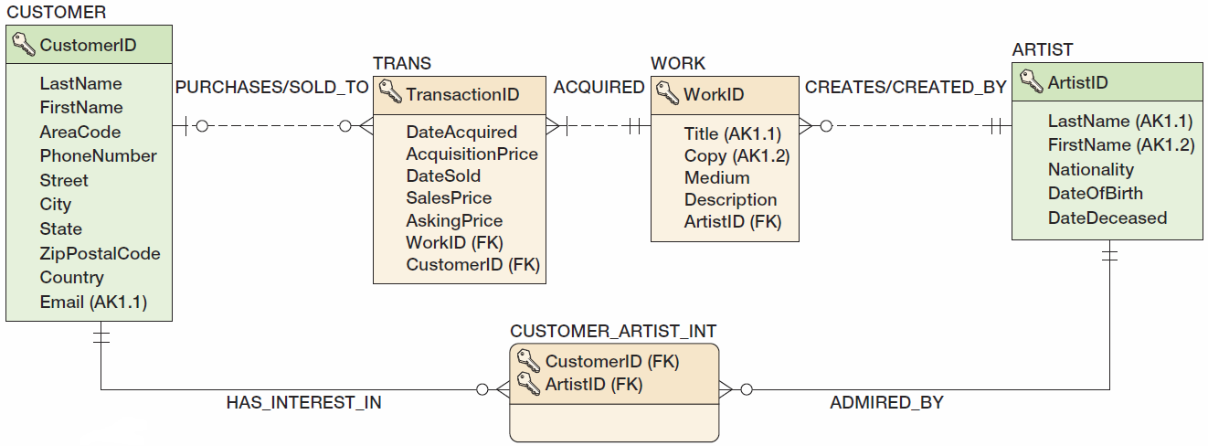
View Ridge Gallery Database Design

Slide 8
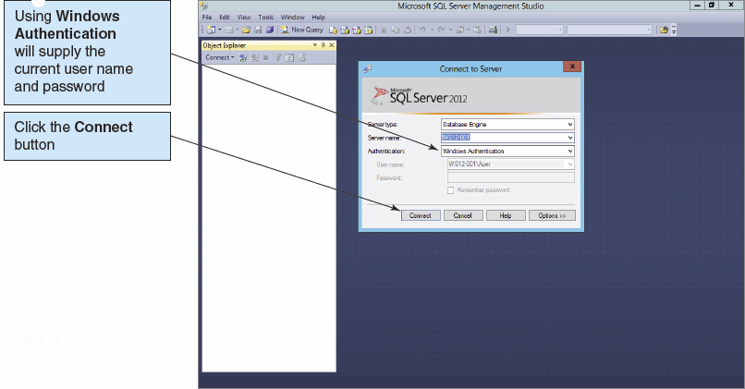
SQL Server 2012 Utilities: Microsoft SQL Server Management Studio I

Slide 9
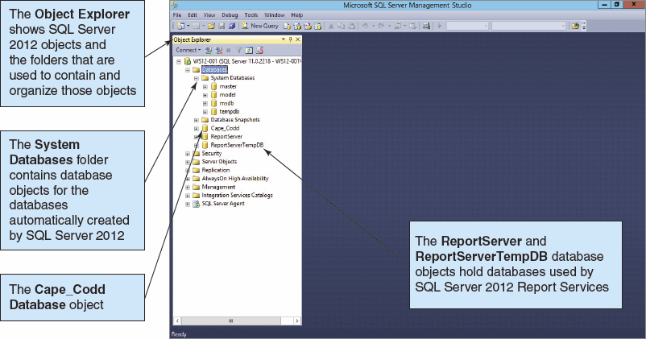
SQL Server 2012 Utilities: Microsoft SQL Server Management Studio II

Slide 10
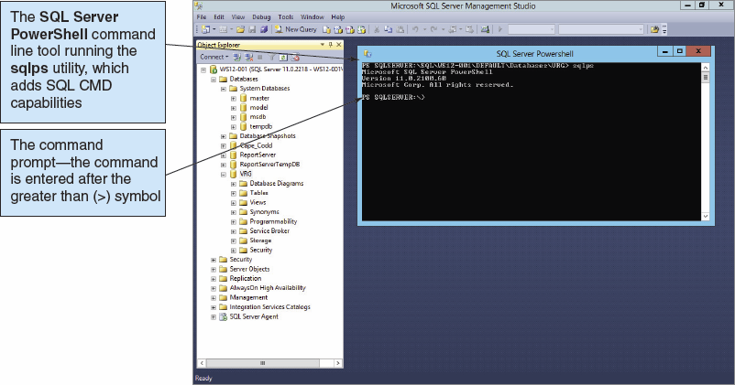
SQL Server 2012 Utilities: Microsoft PowerShell and sqlps Utility I

Slide 11
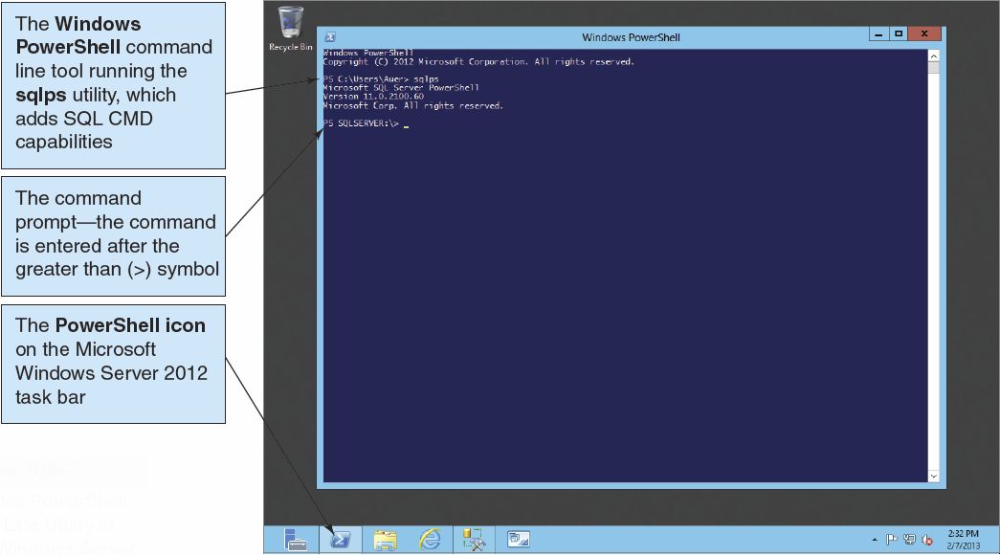
SQL Server 2012 Utilities: Microsoft PowerShell and sqlps Utility II

Slide 12
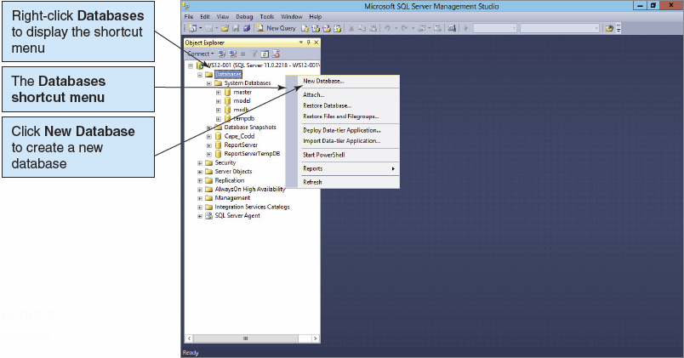
Creating a New Database I

Slide 13
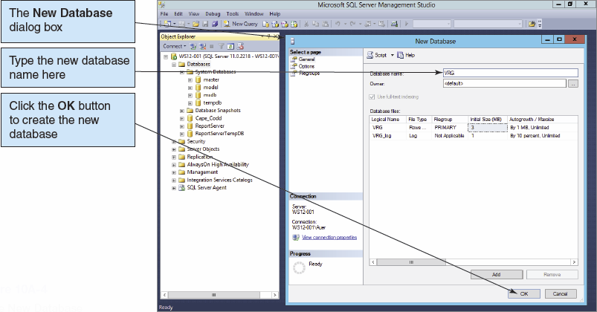
Creating a New Database II

Slide 14
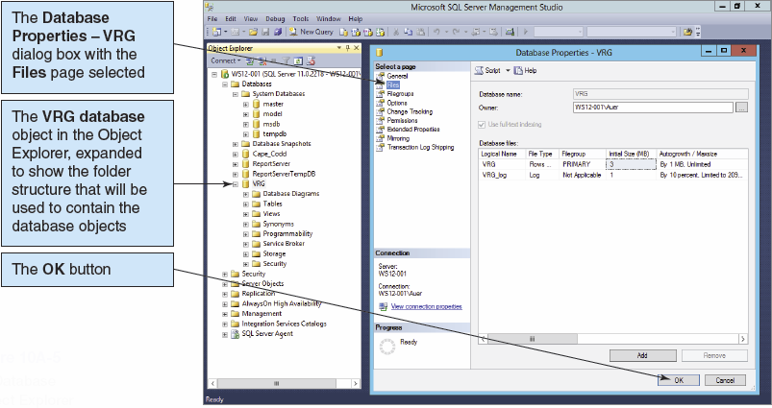
Viewing the New Database

Slide 15
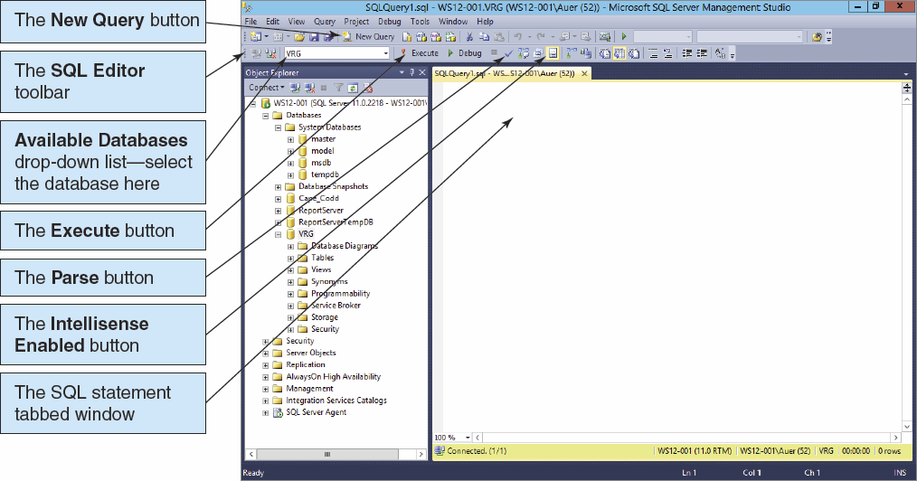
SQL Server 2012 Utilities: Microsoft SQL Server Management Studio III

Slide 16
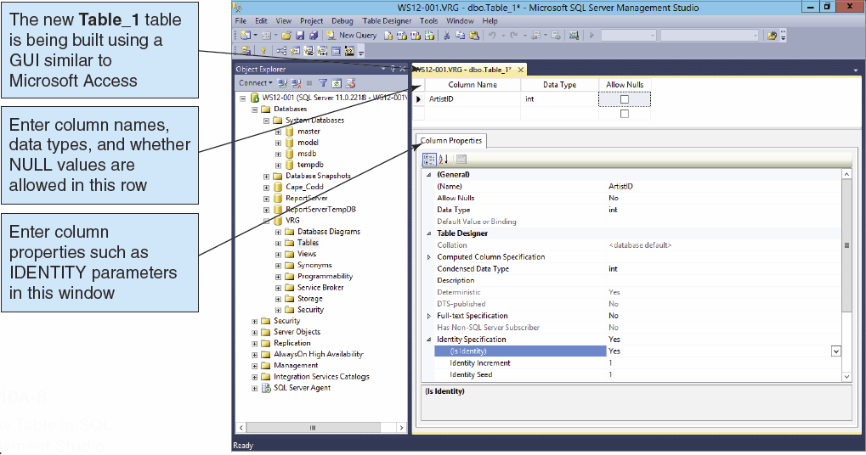
The GUI Table Editor

Slide 17
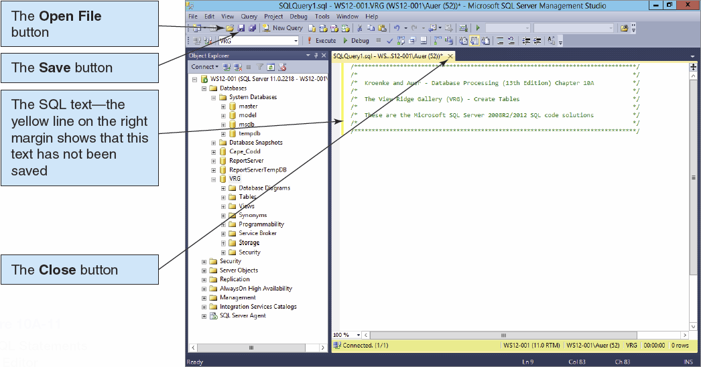
SQL Scripts I

Slide 18
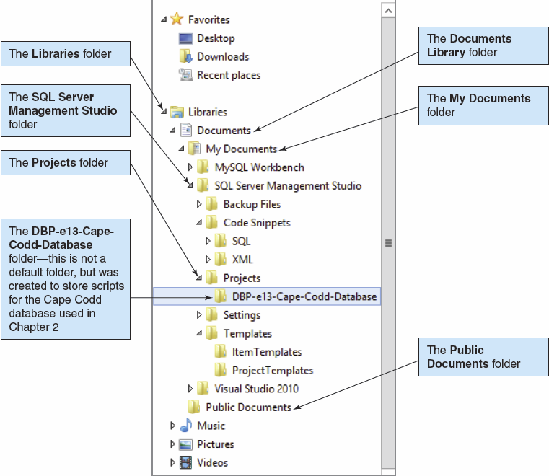
SQL Scripts II

Slide 19
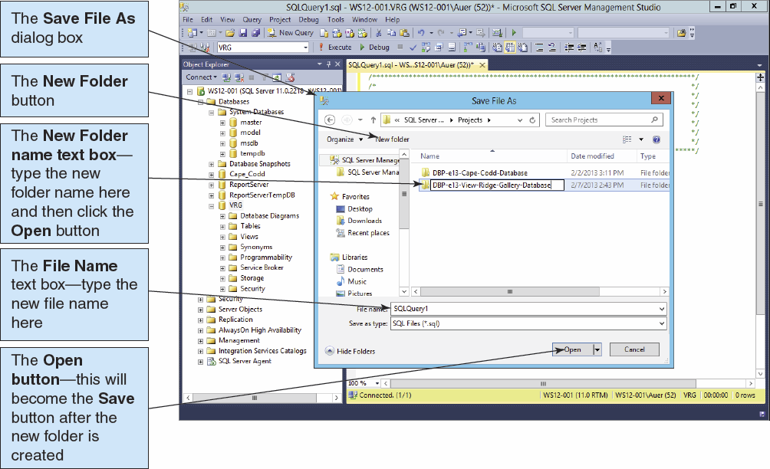
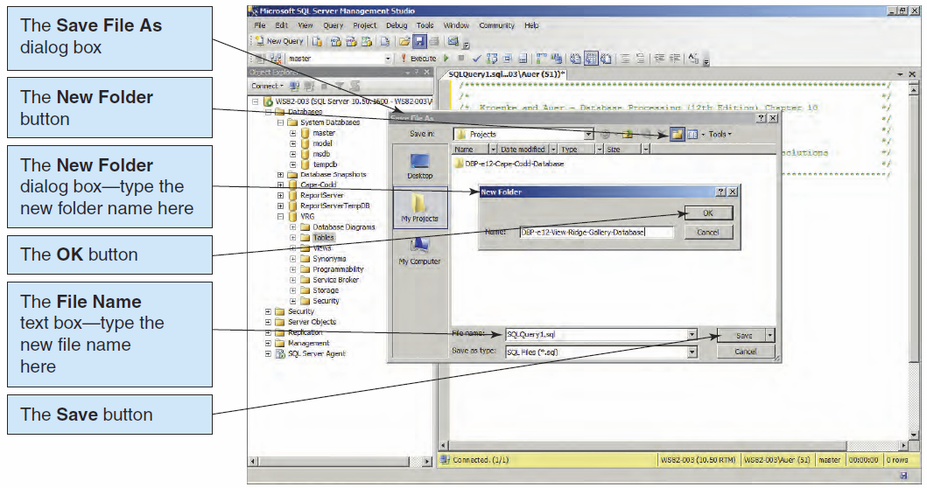
SQL Scripts III

Slide 20
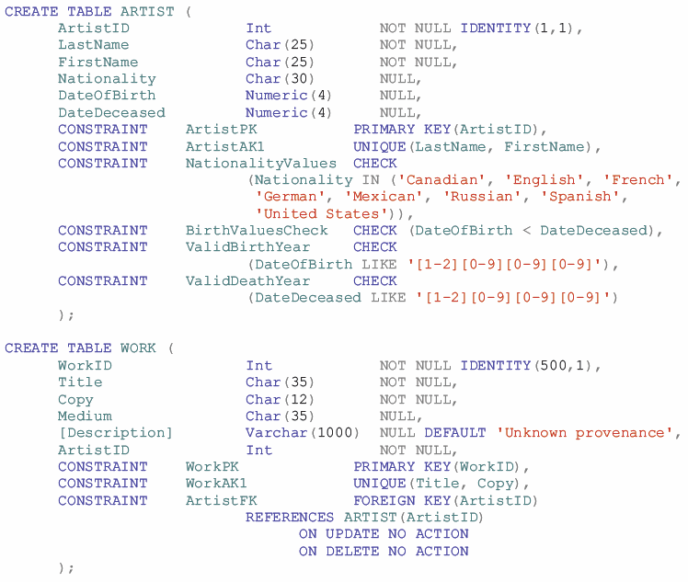
SQL Server CREATE TABLE Statements for the View Ridge Schema I

Slide 21
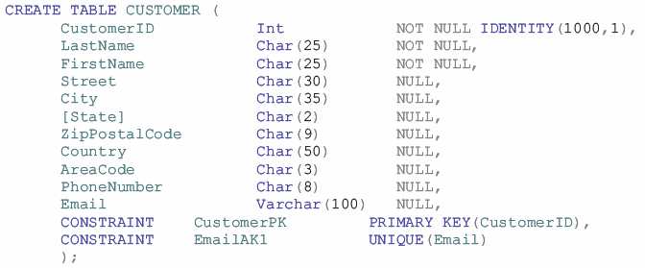
SQL Server CREATE TABLE Statements for the View Ridge Schema II

Slide 22
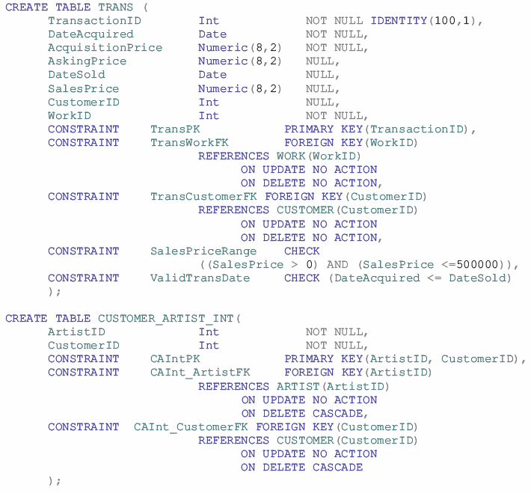
SQL Server CREATE TABLE Statements for the View Ridge Schema III

Slide 23
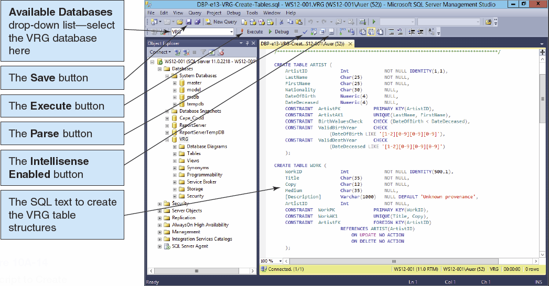
SQL Server CREATE TABLE Statements: Running the Script I

Slide 24
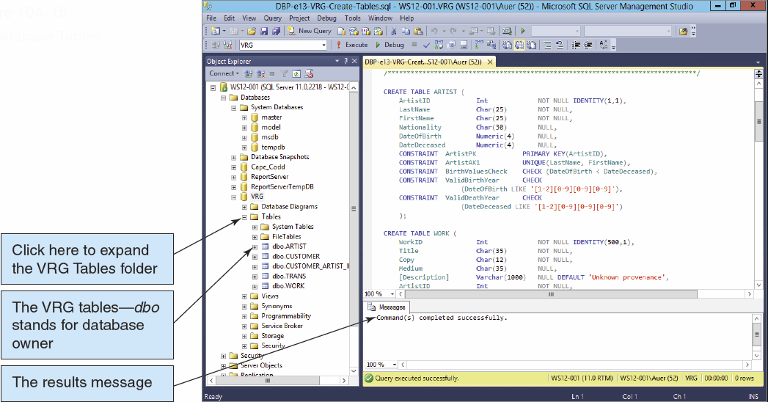
SQL Server CREATE TABLE Statements: Running the Script II

Slide 25
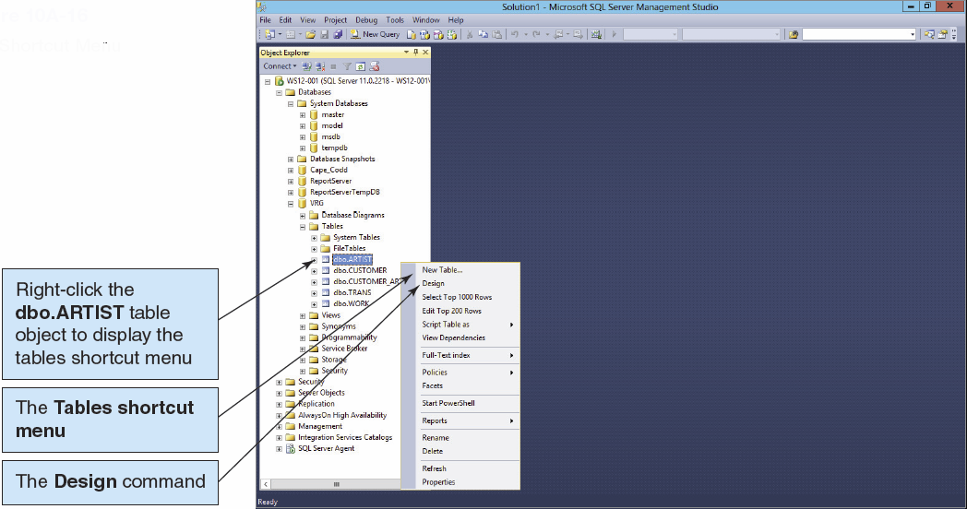
Viewing Tables in the Microsoft SQL Server Management Studio I

Slide 26
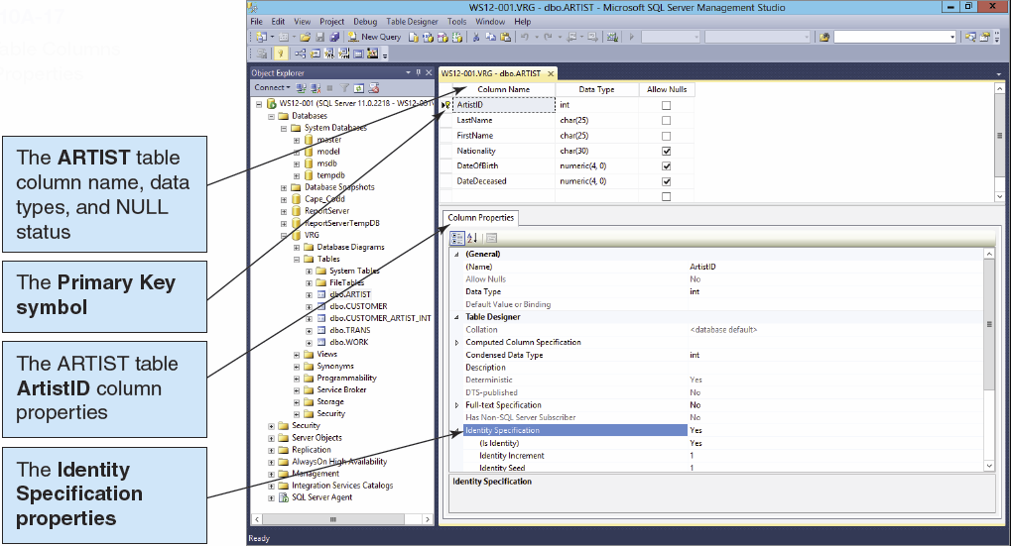
Viewing Tables in the Microsoft SQL Server Management Studio II

Slide 27
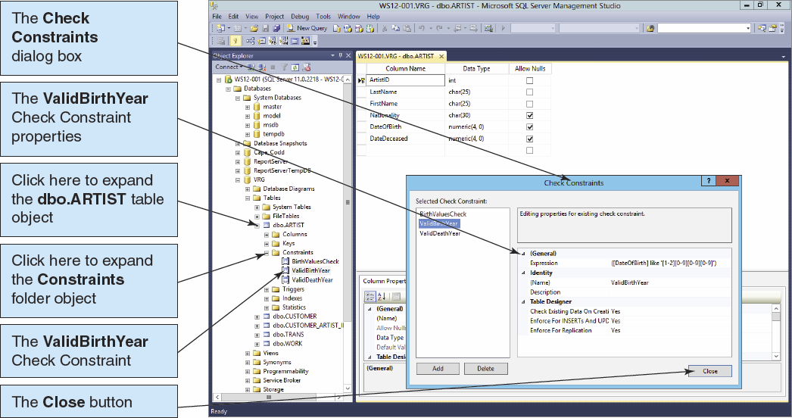
Viewing Tables in the Microsoft SQL Server Management Studio III

Slide 28
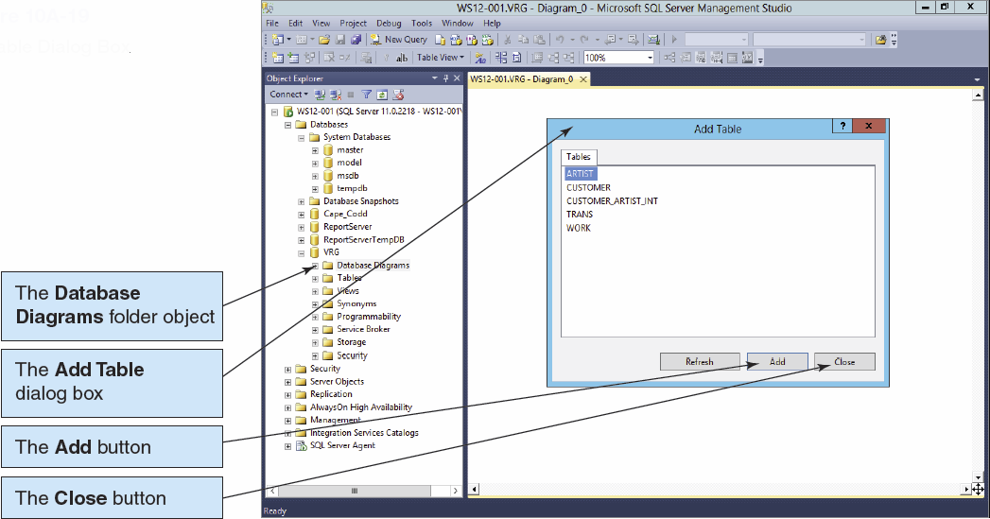
Database Diagrams in the Microsoft SQL Server Management Studio I

Slide 29
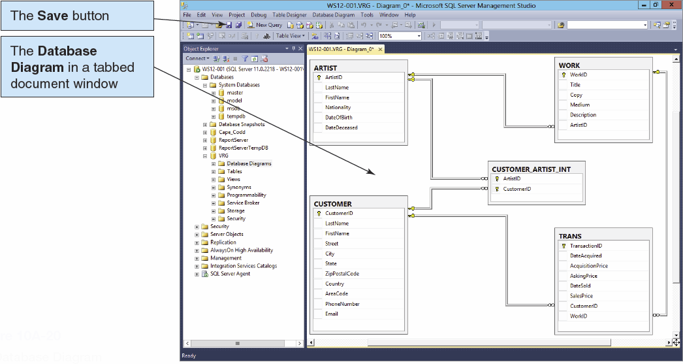
Database Diagrams in the Microsoft SQL Server Management Studio II

Slide 30
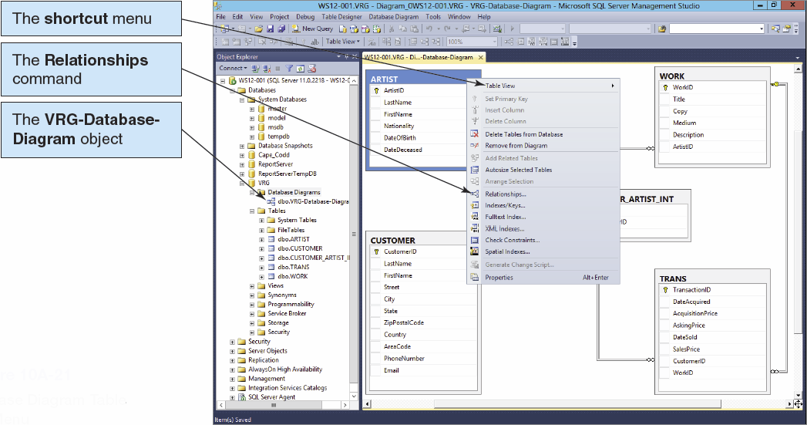
Database Diagrams in the Microsoft SQL Server Management Studio III

Slide 31
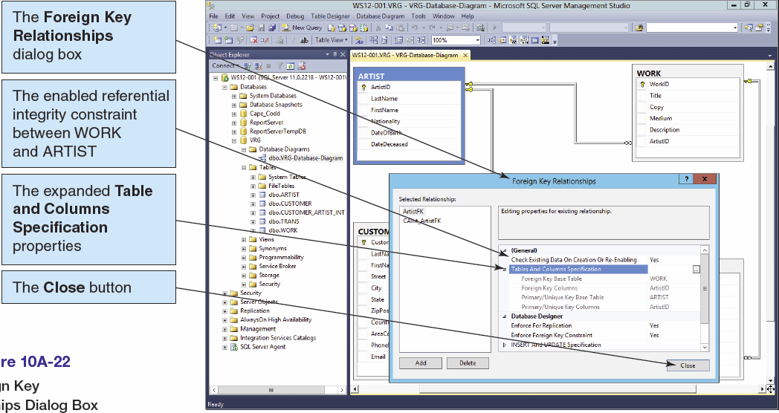
Database Diagrams in the Microsoft SQL Server Management Studio IV

Slide 32
Indexes
Indexes are special data structures used to improve database performance.
SQL Server automatically creates an index on all primary and foreign keys.
Additional indexes may be assigned on other columns that are:
Frequently used in WHERE clauses.
Used for sorting data.

Slide 33
Indexes
SQL Server supports two kinds of indexes:
Clustered index: the data are stored in the bottom level of the index and in the same order as that index
Nonclustered index: the bottom level of an index contains pointers to the data
Clustered indexes are faster than nonclustered indexes for updating and retrieval.

Slide 34
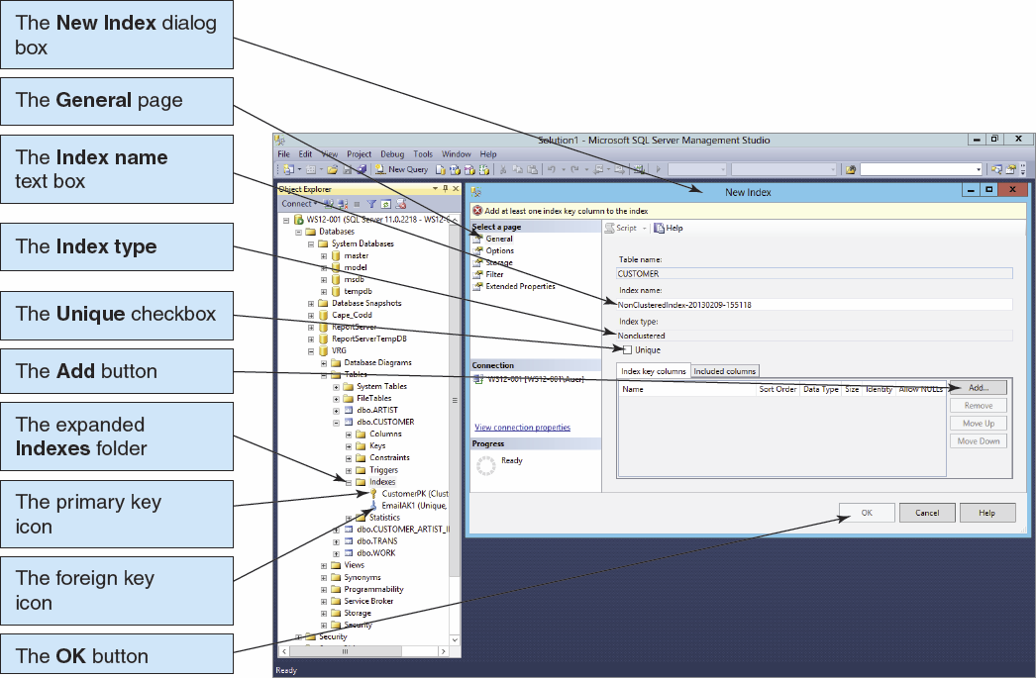
Creating an Index

Slide 35
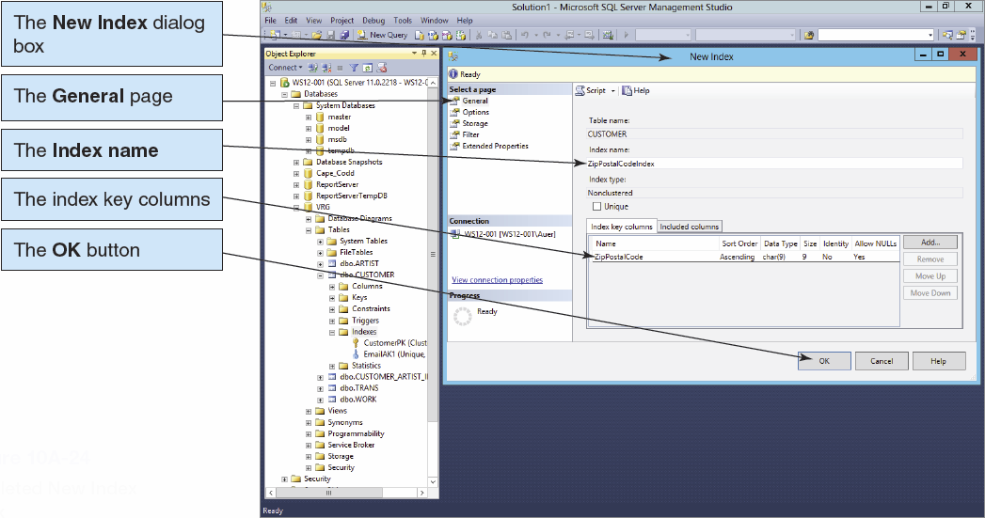
Creating an Index II

Slide 36
Populating the Tables: The IDENTITY Keyword
The IDENTITY keyword implements a new constraint for surrogate keys.
IDENTITY (m, n) creates a surrogate key with an Identity Seed (StartValue) of m and an Identity Increment of n:
CREATE TABLE CUSTOMER(
CustomerID int NOT NULL IDENTITY (1000,1),
Name char(25) NOT NULL,
CONSTRAINT CustomerPK PRIMARY KEY (CustomerID),
CONSTRAINT CustomerAK1 UNIQUE (Name)
);

Slide 37
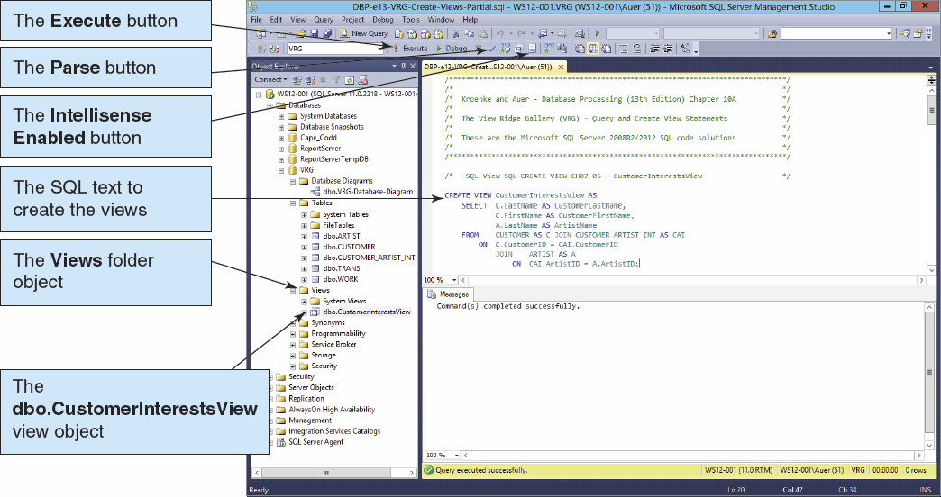
Creating a View in the Microsoft SQL Server Management Studio I

Slide 38
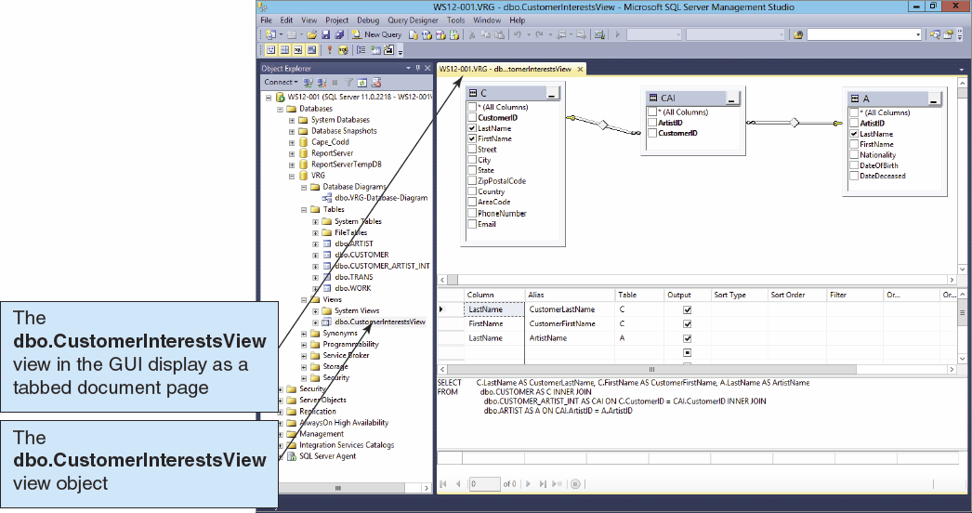
Creating a View in the Microsoft SQL Server Management Studio II

Slide 39
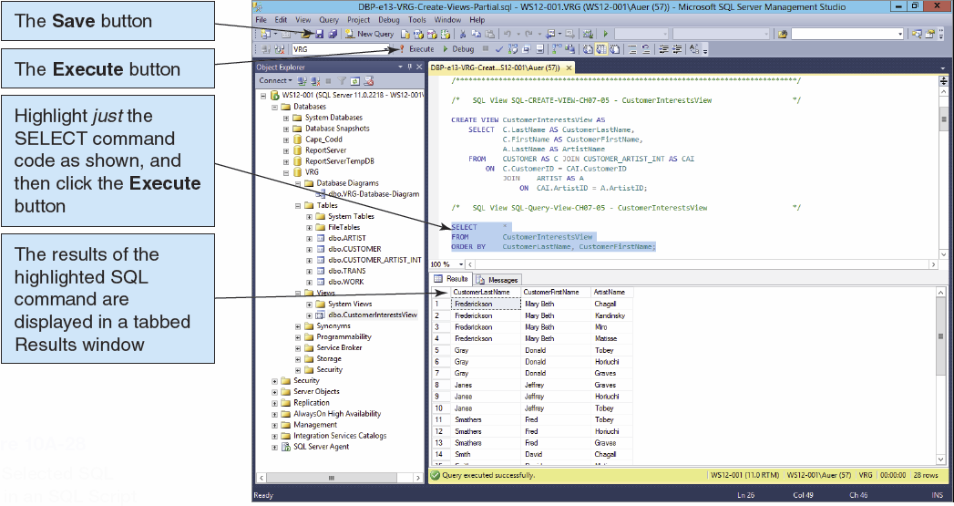
Using a View in the Microsoft SQL Server Management Studio I

Slide 40
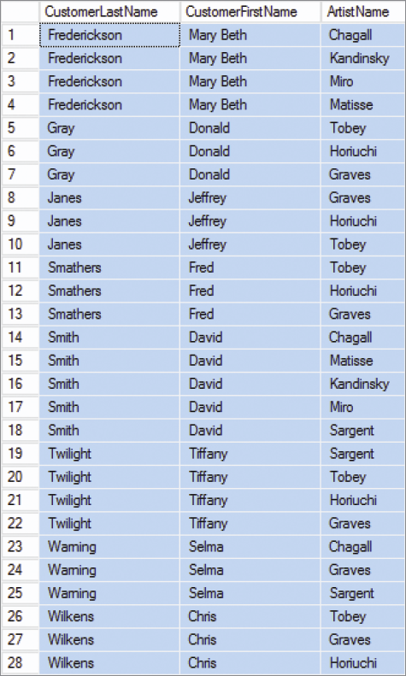
Using a View in the Microsoft SQL Server Management Studio II

Slide 41
Application Logic I
SQL Server database applications can be processed using:
A programming language, e.g., C# .NET, C++. NET, Visual Basic.NET, to invoke SQL Server DBMS commands
PowerShell and the sqlps utility to invoke database commands stored in .sql files
The Microsoft SQL Server Management Studio to invoke database commands stored in .sql files
Stored procedures
Triggers

Slide 42
Application Logic II
SQL Server implements a version of the standard SQL/Persistent Stored Modules (SQL/PSM)
SQL Server’s variant is called Transact-SQL (T-SQL)

Slide 43
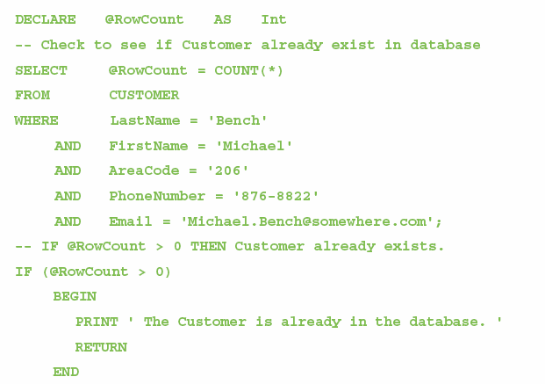
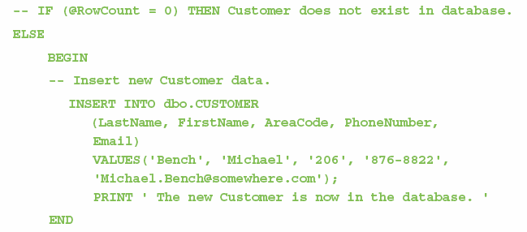
Application Logic: T-SQL Control of Flow Statements
IF…ELSE
BEGIN…END
WHILE
RETURN

Slide 44
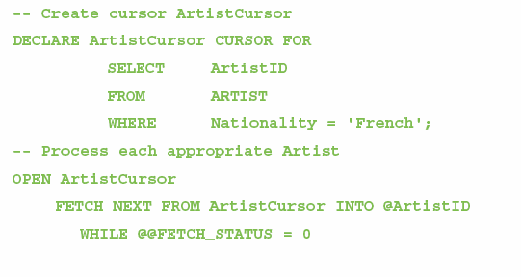
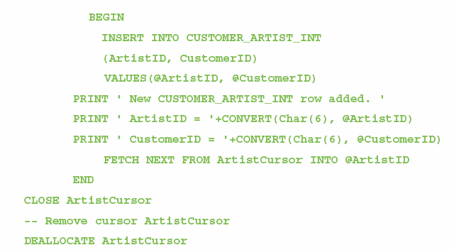
Application Logic: T-SQL Cursor Statements
DECLARE CURSOR
OPEN
FETCH
CLOSE
DEALLOCATE

Slide 45
Application Logic: T-SQL Output Statements
PRINT
CONVERT Function

Slide 46
SQL/Persistent Stored Modules (SSL/PSM)
SQL/Persistent Stored Modules (SQL/PSM) is an ANSI/ISO standard for embedding procedural programming functionality into SQL
Each DBMS product implements SQL/PSM in a different way, with some closer to the standard than others.
Microsoft SQL Server 2012 calls its version Transact-SQL (T-SQL).
Oracle Database 11g Release 2 calls its variant Procedural Language/SQL (PL/SQL).
MySQL 5.6 implements SQL/PSM, but has no special name for its variant of SQL.

Slide 47
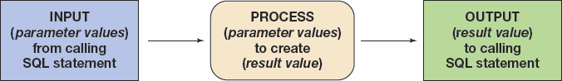
User-Defined Functions I
A user-defined function (stored function) is a stored set of SQL statements that:
is called by name from another SQL statement
may have input parameters passed to it by the calling SQL statement, and
returns an output value to the SQL statement that called the function.

Slide 48
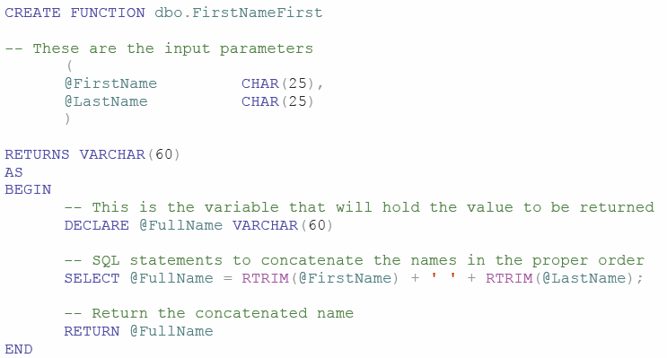
User-Defined Functions II The FirstNameFirst Function

Slide 49
User-Defined Functions III The FirstNameFirst Function
Using the FirstNameFirst function:
SELECT dbo.FristNameFirst(FirstName, LastName) AS CustomerName,
Sreet, City, State, ZipPostalCode
FROM CUSTOMER
ORDER BY CustomerName;

Slide 50
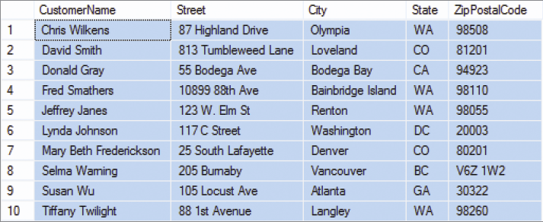
User-Defined Functions IV The FirstNameFirst Function
FirstNameFirst function results:

Slide 51
Stored Procedures
A stored procedure is a compiled program stored within the database.
Transact-SQL surrounds basic SQL statements with programming constructs such as parameters, variables, and logic structures such as IF and WHILE.
Stored procedures are programs that can:
Have parameters.
Invoke other procedures and functions.
Return values.
Raise exceptions.
Creating stored procedures:
Write a stored procedure in a text file and process the commands using the Microsoft SQL Server Management Studio.

Slide 52
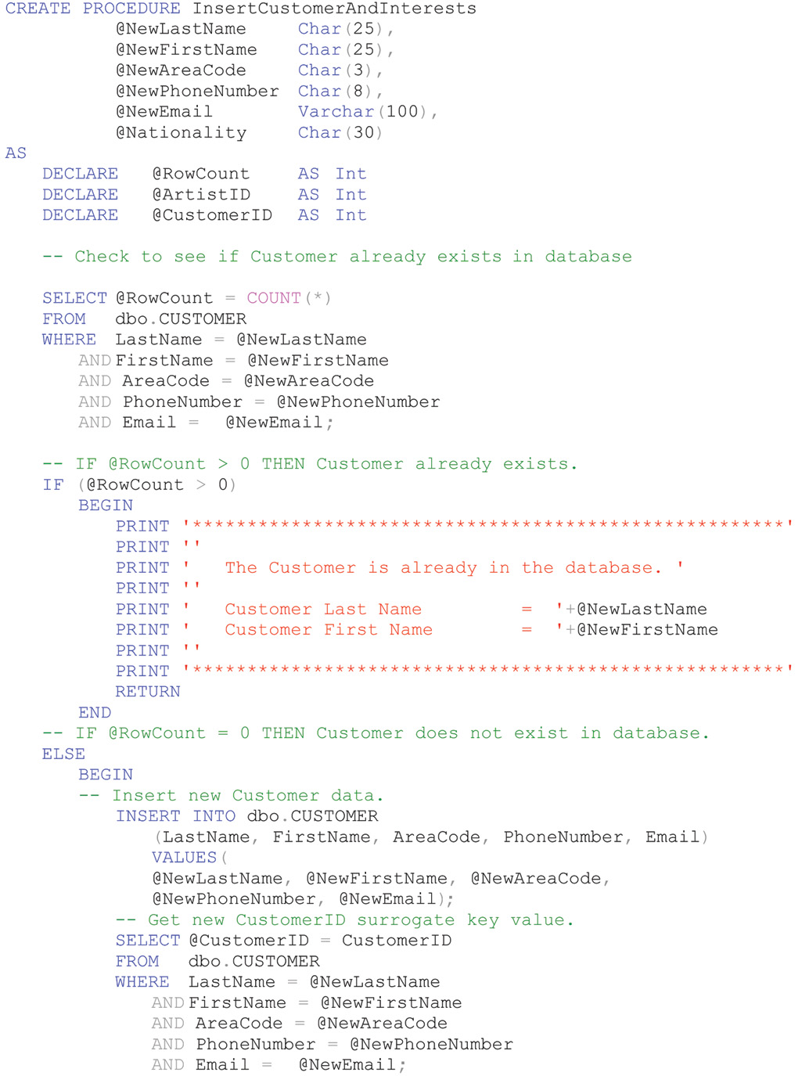

Slide 53
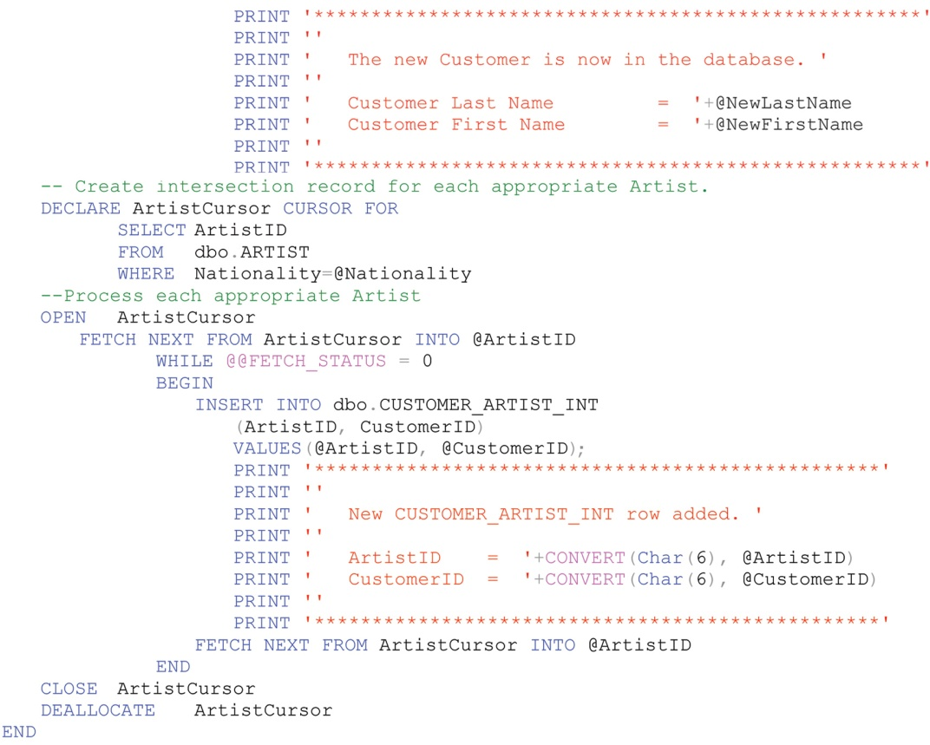

Slide 54
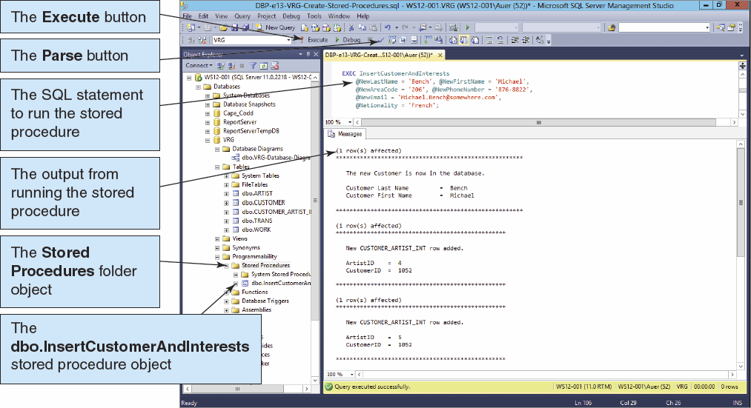
Running Stored Procedures

Slide 55
Triggers
An SQL Server trigger is a procedure that is invoked when a specified database activity occurs.
Triggers can be used to:
Enforce business rules.
Set complex default values.
Update views.
Implement referential integrity actions.
SQL Server only supports INSTEAD OF and AFTER triggers.
A table may have one or more AFTER triggers.
AFTER triggers may not be assigned to views.
A view or table may have only one INSTEAD OF trigger for each triggering action.
Triggers can roll back the transactions that caused them to be fired.

Slide 56
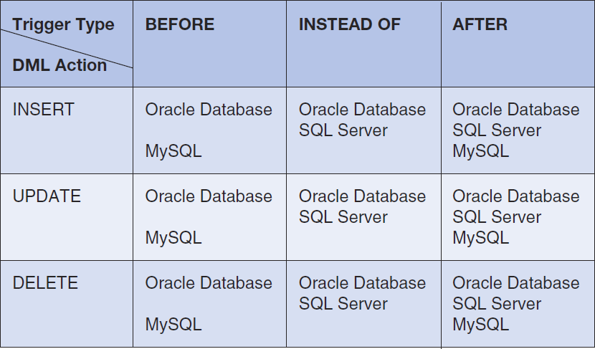
Triggers Comparison

Slide 57
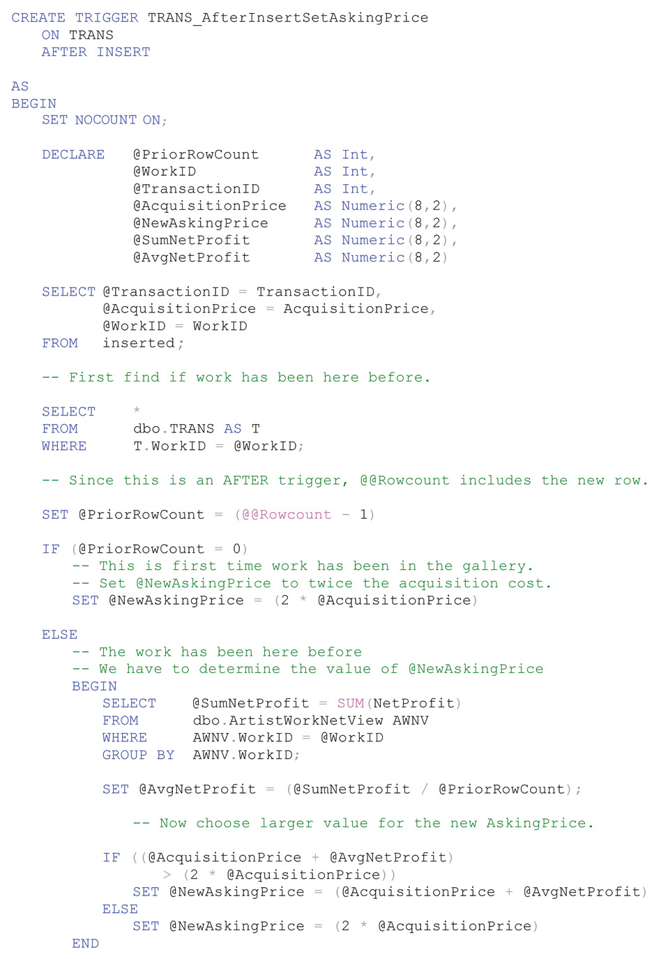

Slide 58
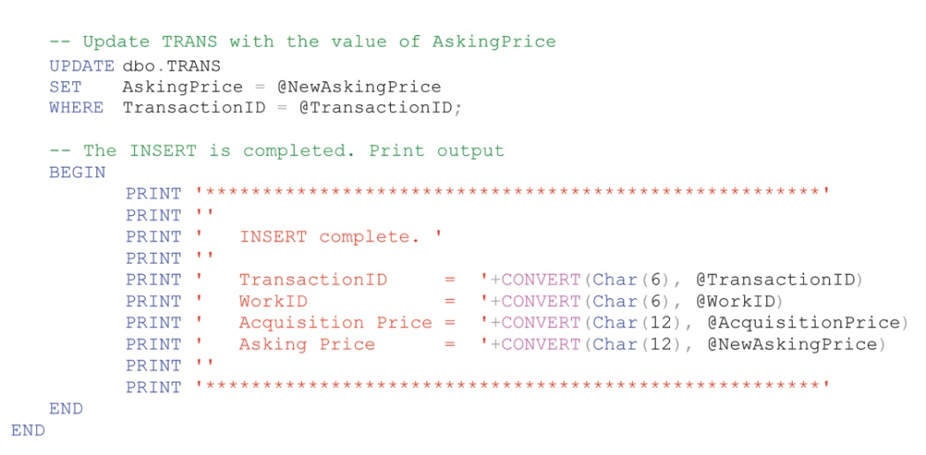

Slide 59
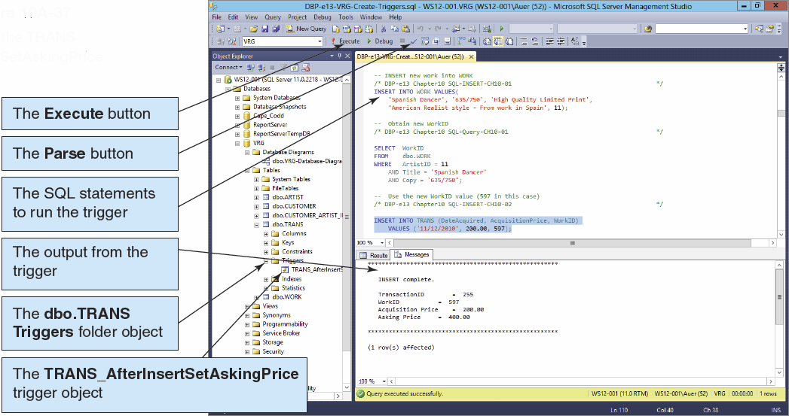
Running Triggers

Slide 60
Concurrency Control
Three factors determine the concurrency control behavior of SQL Server.
Transaction isolation level
Cursor concurrency setting
Locking hints provided in the SELECT clause
Locking behavior also changes, depending on whether actions occur in the context of transactions or cursors independently.
Therefore, SQL Server places locks on behalf of the developer.
Locks may be placed at many levels of granularity and may be promoted or demoted as work progresses.

Slide 61
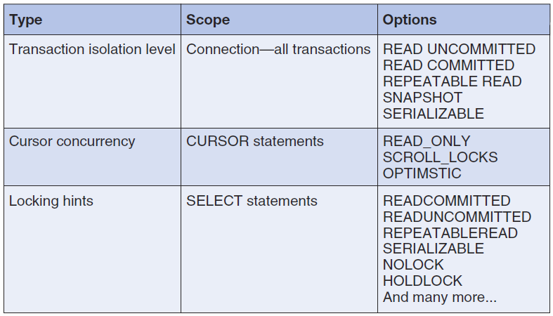
SQL Server Concurrency Options

Slide 62
SQL Server 2012 Security
SQL server provides two modes of authentication:
Windows only: the authentication is provided by the windows operating system.
Mixed security: SQL Server will accept either the windows-authenticated user name or it will perform its own authentication.

Slide 63
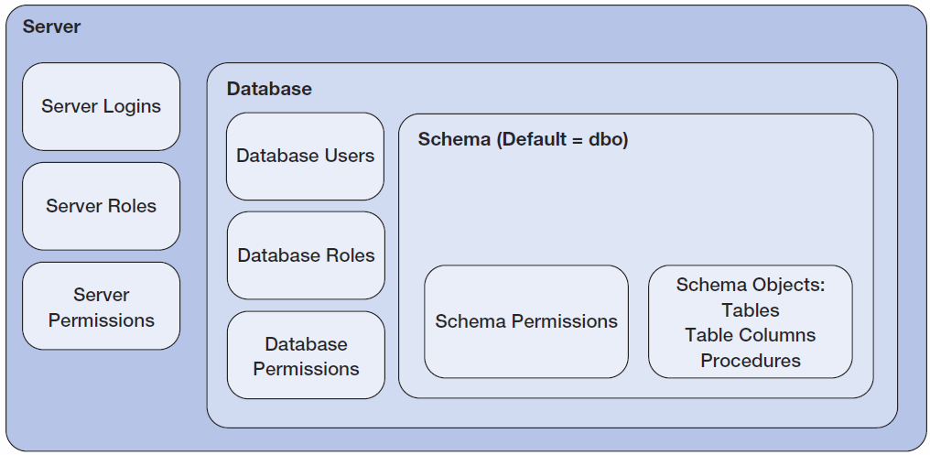
SQL Server 2012 Security Model

Slide 64
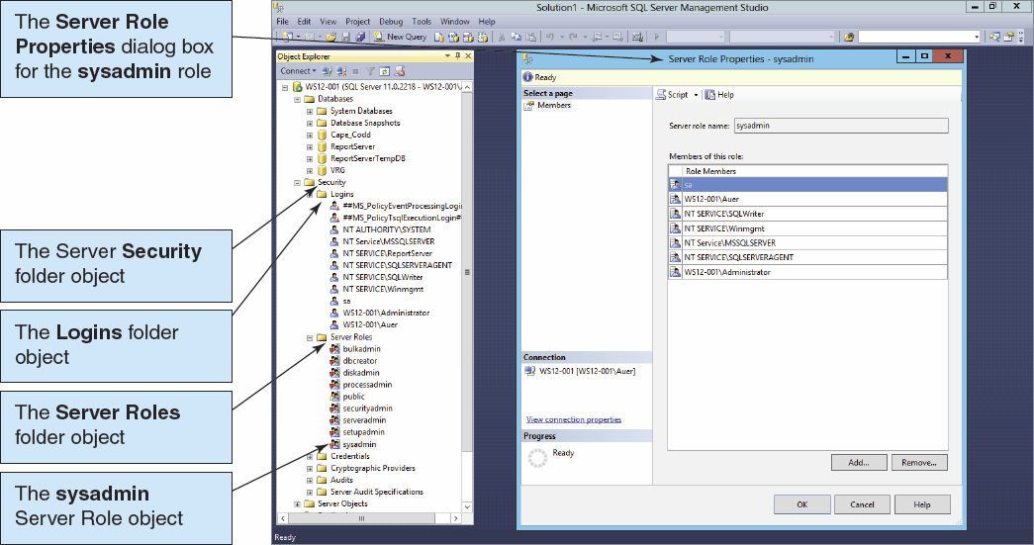
SQL Server 2012 Logins and Roles I

Slide 65
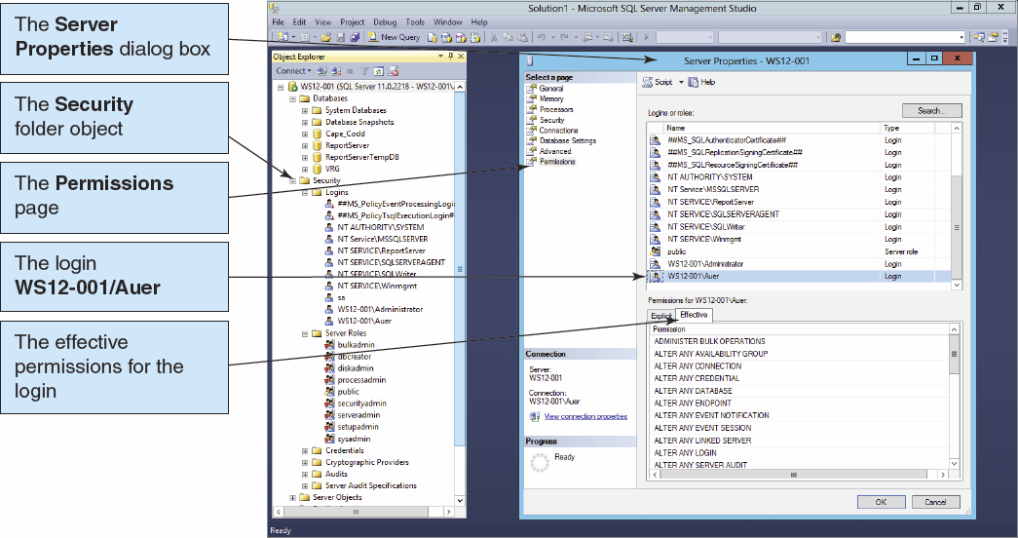
SQL Server 2012 Logins and Roles II

Slide 66

SQL Server 2012 Logins and Roles III

Slide 67

SQL Server 2012 Logins and Roles IV

Slide 68

SQL Server 2012 Logins and Roles V

Slide 69

SQL Server 2012 Logins and Roles VI

Slide 70
SQL Server Backup
SQL Server supports several types of backup:
A complete backup makes a copy of the entire database.
A differential backup makes a copy of the database changes since the last complete backup.
Differential backups are faster and can be taken more frequently.
Complete backups are simpler to use for recovery.
The transaction log also needs to be periodically backed up.

Slide 71
Database Recovery
Both data and log files are created by SQL Server.
SQL Server provides a wizard for setting up database maintenance plan, e.g., scheduling database and log backups.
To recover a database with SQL Server:
The database is restored from a prior database backup.
Log after images are applied to the restored database.
At the end of the log, changes from any transaction that failed to commit are then rolled back.

Slide 72

SQL Server 2012 Backup

Slide 73
SQL Server Recovery Models
Three recovery models:
Simple recovery: neither logging is done nor log records applied
To recover a database is to restore the database to the last backup.
This method can be used for a database that is never changed.
Full recovery: all database changes are logged
Bulk-logged: all changes are logged except those that cause large log entries

Slide 74

SQL Server 2012 Restore

Slide 75
David Kroenke and David Auer Database Processing Fundamentals, Design, and Implementation (13th Edition)
End of Presentation:
Chapter Ten A

Slide 76

All rights reserved. No part of this publication may be reproduced, stored in a retrieval system, or transmitted, in any form or by any means, electronic, mechanical, photocopying, recording, or otherwise, without the prior written permission of the publisher. Printed in the United States of America.

